Slide 1

Background
CSK Auto uses OnBoard for onboarding exercise
CSK Auto has configured 2 tours
Pre Joining Tour (Type - PreBoard )
30 days (tour window)
Welcome Tour (Type - OnBoard)
45 days (tour window)
John is assigned both the tours
John S. Bruno
2015
2015
Hired by CSK Auto Inc.
Joining date: 15th June
Today

Slide 2
OnBoard Standalone

Slide 3
Timelines for John (OnBoard Standalone)
OnBoard tour Available
PreBoard tour Due Date
45 Days Window for OnBoard Tour
30 Days Window for PreBoard Tour
John Hired
2015
2015
May 17th
June 15th
July 29th
Today
PreBoard Available
Date of Joining
OnBoard Due Date

Slide 4
Standalone
30 Days Window for PreBoard Tour
45 Days Window for OnBoard Tour
John Hired
May 17th
June 15th
July 29th
PreBoard Available
Date of Joining
OnBoard Due Date
2015
2015
Only PreBoard is Available
1. PreBoard is Available (Overdue)
2.OnBoard is Available
PreBoard and OnBoard
Both Are Overdue
No Tour Available
Today

Slide 5
OnBoard + BenAdmin (No Waiting Period)

Slide 6
Timelines for John (No Waiting Period)
OnBoard tour Available
PreBoard tour Due Date
45 Days Window for OnBoard Tour
30 Days Window for PreBoard Tour
John Hired
New Hire Enroll
2015
2015
May 17th
June 15th
July 29th
Today
PreBoard Available
Date of Joining
OnBoard Due Date
July 14th
New Hire
Enrollment Window Starts
New Hire
Enrollment Window Ends

Slide 7
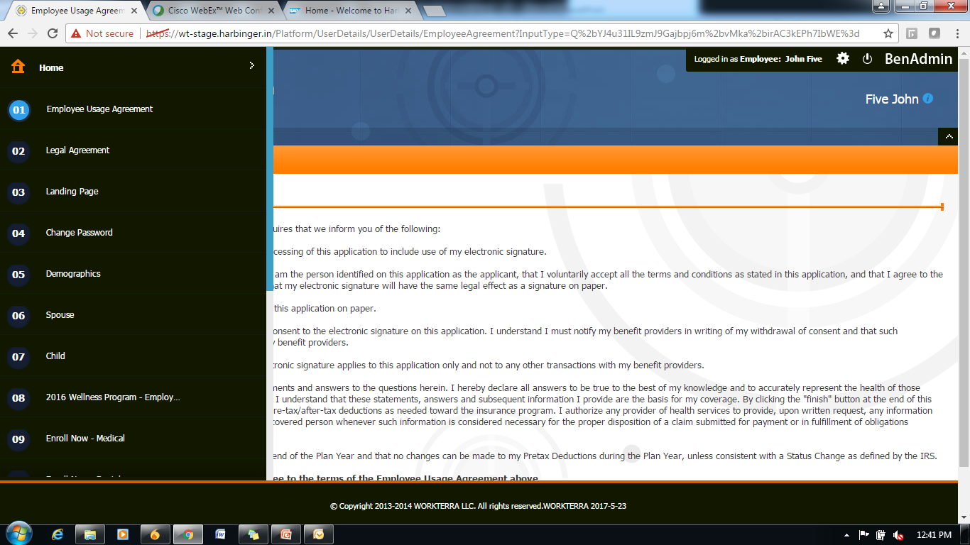
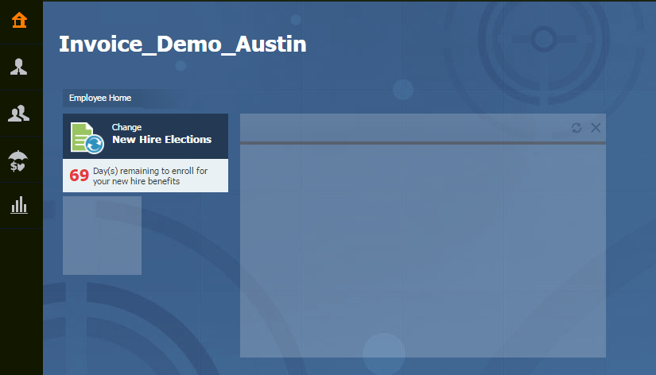
Case 1: Before PreBoard is Available
30 Days Window for PreBoard Tour
45 Days Window for OnBoard Tour
John Hired
New Hire Enroll
May 17th
June 15th
July 14th
July 29th
PreBoard Available
Date of Joining
New Hire
Enrollment Window Ends
OnBoard Due Date
New Hire
Enrollment Window Starts
2015
2015
BenAdmin Tunnel
BenAdmin Dashboard
Today

Slide 8
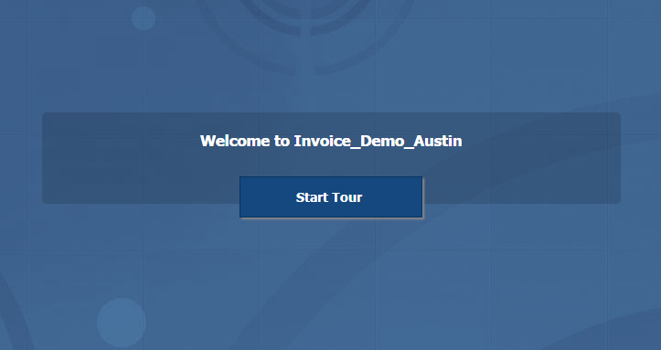
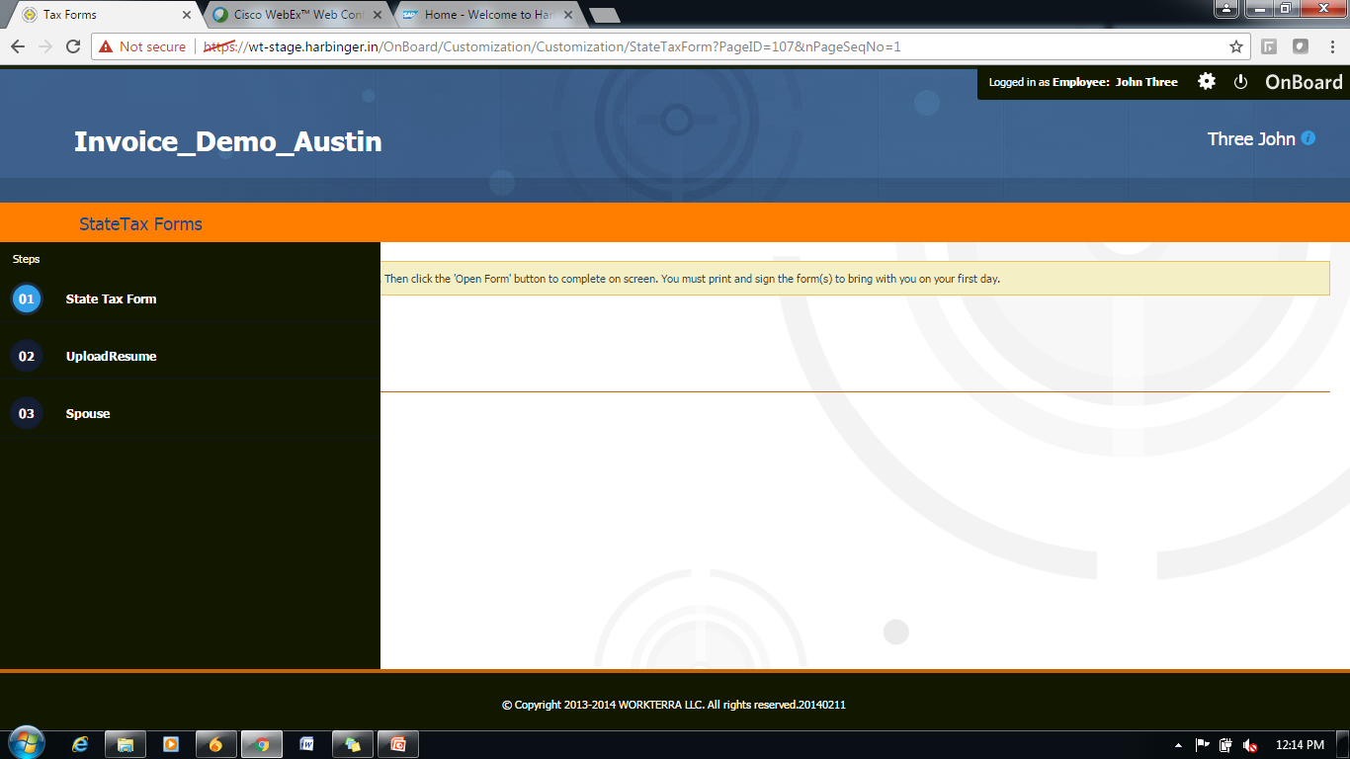
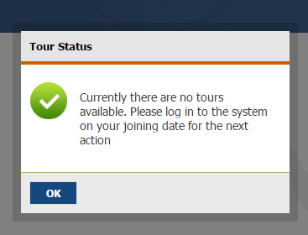
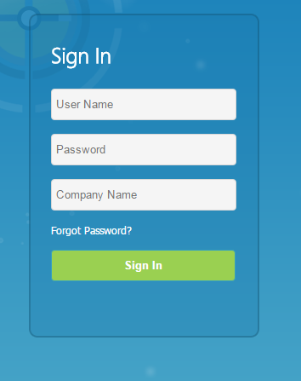
Case 2: After PreBoard is Available, Before Date of Joining
30 Days Window for PreBoard Tour
45 Days Window for OnBoard Tour
John Hired
New Hire Enroll
May 17th
June 15th
July 14th
July 29th
PreBoard Available
Date of Joining
New Hire
Enrollment Window Ends
OnBoard Due Date
New Hire
Enrollment Window Starts
2015
2015
Today
Start PreBoard
PreBoard Tunnel
Login Page
BenAdmin Tunnel
BenAdmin Dashboard
PreBoard Complete Logout
Notes:
PreBoard – To – BenAdmin Tunnel (No Login needed)

Slide 9
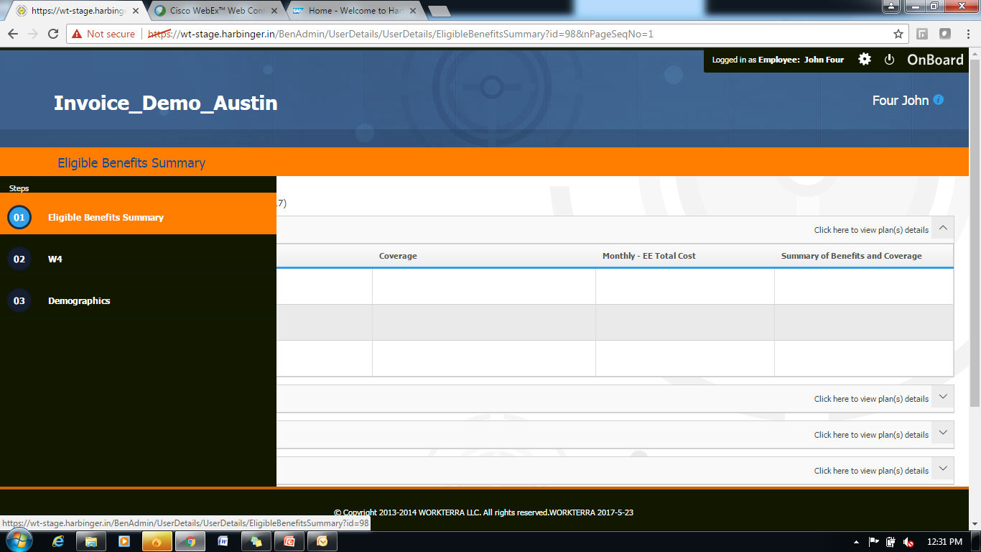
Case 3: In New Hire Enrollment Window
30 Days Window for PreBoard Tour
45 Days Window for OnBoard Tour
John Hired
New Hire Enroll
May 17th
June 15th
July 14th
July 29th
PreBoard Available
Date of Joining
New Hire
Enrollment Window Ends
OnBoard Due Date
New Hire
Enrollment Window Starts
2015
2015
Today
Start PreBoard
PreBoard Tunnel
Start OnBoard
OnBoard Tunnel
BenAdmin Tunnel
BenAdmin Dashboard

Slide 10
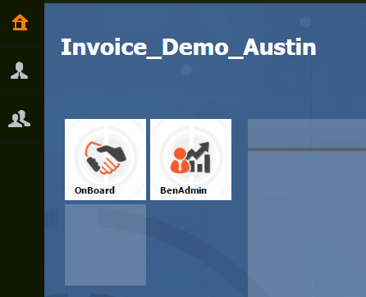
Case 4: After New Hire Enrollment Window, Before OnBoard Due Date
30 Days Window for PreBoard Tour
45 Days Window for OnBoard Tour
John Hired
New Hire Enroll
May 17th
June 15th
July 14th
July 29th
PreBoard Available
Date of Joining
New Hire
Enrollment Window Ends
OnBoard Due Date
New Hire
Enrollment Window Starts
2015
2015
Today
Start PreBoard
PreBoard Tunnel
Start OnBoard
OnBoard Tunnel
Employee Dashboard

Slide 11
Case 5: After OnBoard Due Date
30 Days Window for PreBoard Tour
45 Days Window for OnBoard Tour
John Hired
New Hire Enroll
May 17th
June 15th
July 14th
July 29th
PreBoard Available
Date of Joining
New Hire
Enrollment Window Ends
OnBoard Due Date
New Hire
Enrollment Window Starts
2015
2015
Today
Start PreBoard
PreBoard Tunnel
Start OnBoard
OnBoard Tunnel
Employee Dashboard

Slide 12
OnBoard with BenAdmin (No Waiting Period)
30 Days Window for PreBoard Tour
45 Days Window for OnBoard Tour
John Hired
New Hire Enroll
May 17th
June 15th
July 29th
PreBoard Available
Date of Joining
July 14th
OnBoard Due Date
New Hire Enrollment
Window Starts
New Hire Enrollment
Window End
PreBoard Availability
2015
2015
OnBoard Availability
Today
Forms saving using OnBoard
Forms saving using BenAdmin
QE
QE

Slide 13
OnBoard + BenAdmin (With Waiting Period)

Slide 14
Timelines for John (With Waiting Period)
30 Days Window for PreBoard Tour
45 Days Window for OnBoard Tour
John Hired
10 Days
30 Days
PreBoard Available
Date of Joining
OnBoard Due Date
Waiting Period
Enrollment Window

Slide 15
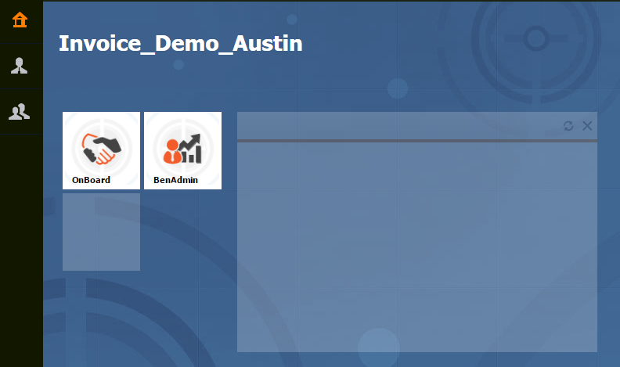
Case1 : Before PreBoard is Available
30 Days Window for PreBoard Tour
45 Days Window for OnBoard Tour
John Hired
10 Days
30 Days
PreBoard Available
Date of Joining
OnBoard Due Date
Waiting Period
Enrollment Window

Slide 16
Case2 : After PreBoard is Available but Before Date of Joining
30 Days Window for PreBoard Tour
45 Days Window for OnBoard Tour
John Hired
10 Days
30 Days
PreBoard Available
Date of Joining
OnBoard Due Date
Waiting Period
Enrollment Window
Start PreBoard
PreBoard Tunnel
Login Page
BenAdmin Dashboard
PreBoard Complete Logout

Slide 17
Case3 : In Waiting Period (Assuming PreBoard Not Completed)
30 Days Window for PreBoard Tour
45 Days Window for OnBoard Tour
John Hired
10 Days
30 Days
PreBoard Available
Date of Joining
OnBoard Due Date
Waiting Period
Enrollment Window
Start PreBoard
PreBoard Tunnel
Start OnBoard
OnBoard Tunnel
Employee Dashboard

Slide 18
Case4: Enrollment Window Followed by Waiting Period (Assuming Tour not completed)
30 Days Window for PreBoard Tour
45 Days Window for OnBoard Tour
John Hired
10 Days
30 Days
PreBoard Available
Date of Joining
OnBoard Due Date
Waiting Period
Enrollment Window
Start PreBoard
PreBoard Tunnel
Start OnBoard
OnBoard Tunnel
BenAdmin Tunnel
Employee Dashboard

Slide 19
Case5 : After Enrollment Window Before OnBoard Due Date
30 Days Window for PreBoard Tour
45 Days Window for OnBoard Tour
John Hired
10 Days
30 Days
PreBoard Available
Date of Joining
OnBoard Due Date
Waiting Period
Enrollment Window
Start PreBoard
PreBoard Tunnel
Start OnBoard
OnBoard Tunnel
Employee Dashboard

Slide 20
Case6 : After Enrollment Window and OnBoard Due Date
30 Days Window for PreBoard Tour
45 Days Window for OnBoard Tour
John Hired
10 Days
30 Days
PreBoard Available
Date of Joining
OnBoard Due Date
Waiting Period
Enrollment Window
Start PreBoard
PreBoard Tunnel
Start OnBoard
OnBoard Tunnel
Employee Dashboard

Slide 21
OnBoard with BenAdmin (Waiting Period : 10 Days)
30 Days Window for PreBoard Tour
45 Days Window for OnBoard Tour
John Hired
10 Days
New Hire Enroll
May 17th
June 15th
July 29th
PreBoard Available
Date of Joining
June 25th
July 24th
New Hire Enrollment
Window End
OnBoard Due Date
New Hire Enrollment Start
PreBoard Availability
2015
2015
OnBoard Availability
Today
Forms saving using OnBoard
Forms saving using BenAdmin
QE
QE
QE
QE
QE

Slide 22
OnBoard + BenAdmin (New Approach)

Slide 23
OnBoard with BenAdmin (No Waiting Period)
30 Days Window for PreBoard Tour
45 Days Window for OnBoard Tour
John Hired
New Hire Enroll
May 17th
June 15th
July 29th
PreBoard Available
Date of Joining
July 14th
OnBoard Due Date
New Hire Enrollment
Window Starts
New Hire Enrollment
Window End
No Tour Available After New Hire Enrollment Window
PreBoard Availability
2015
2015
OnBoard Availability
Today
Forms saving using OnBoard
Forms saving using BenAdmin
QE
QE

Slide 24
OnBoard with BenAdmin (Waiting Period : 10 Days)
30 Days Window for PreBoard Tour
45 Days Window for OnBoard Tour
John Hired
10 Days
New Hire Enroll
May 17th
June 15th
June 25th
July 29th
PreBoard Available
Date of Joining
New Hire Enrollment Start
July 24th
OnBoard Due Date
No Tour Before Enrollment Window
New Hire Enrollment
Window End
No Tour Available After New Hire Enrollment Window
PreBoard Availability
2015
2015
OnBoard Availability
Today
Forms saving using OnBoard
Forms saving using BenAdmin
QE
QE
QE
QE
QE

Slide 25
Post NH Date Experience

Slide 26
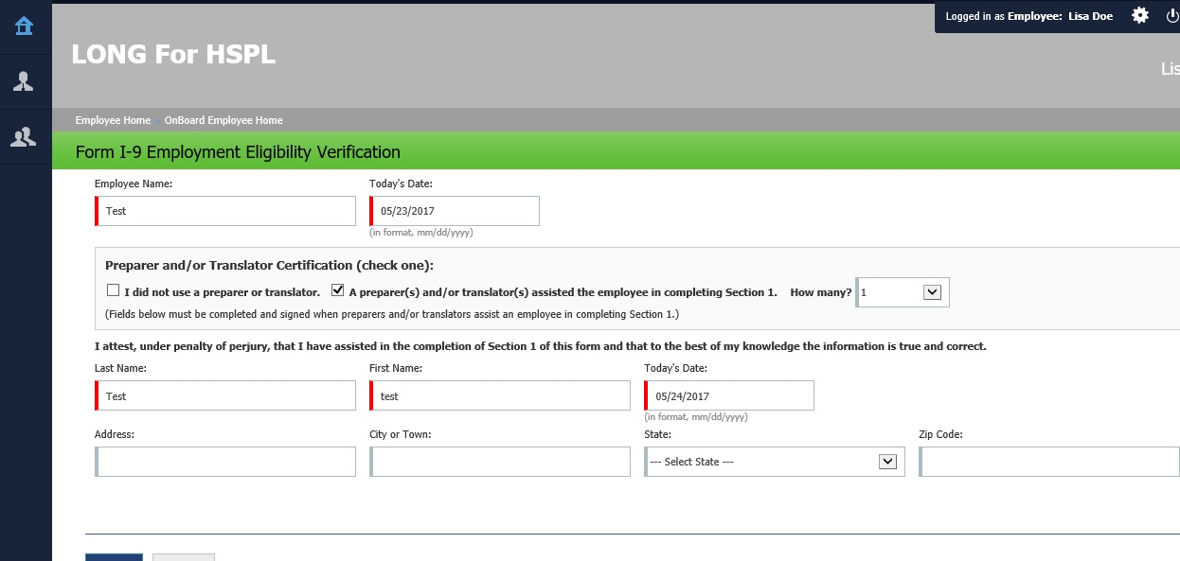
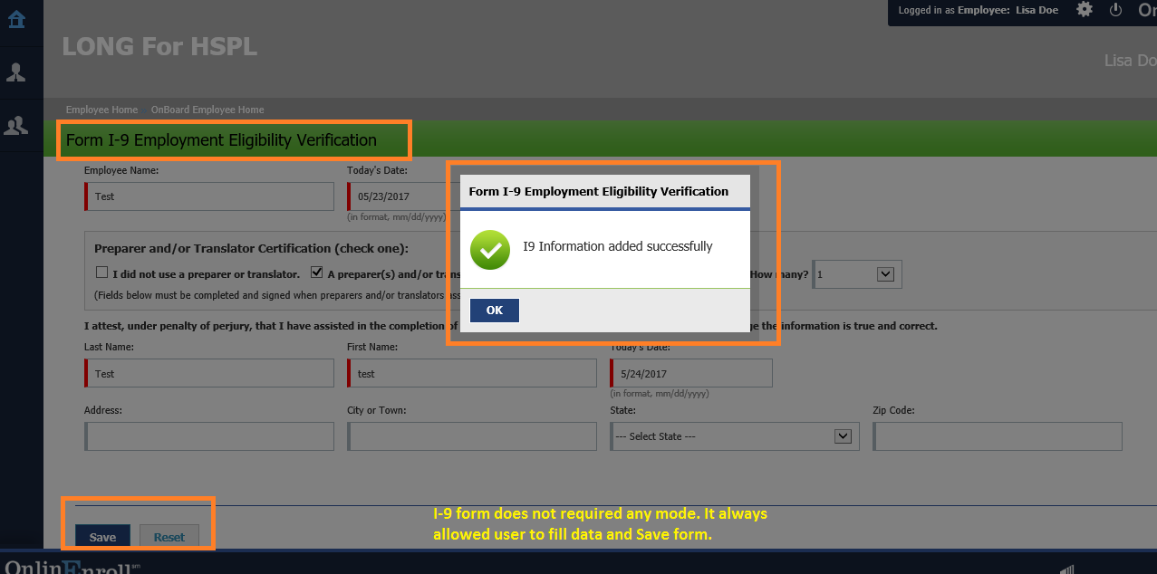
Post New Hire (With No Mode Available) – System Forms
Static Form (e.g. I9) – Available for Editing
Popup Shown on Saving the Page

Slide 27
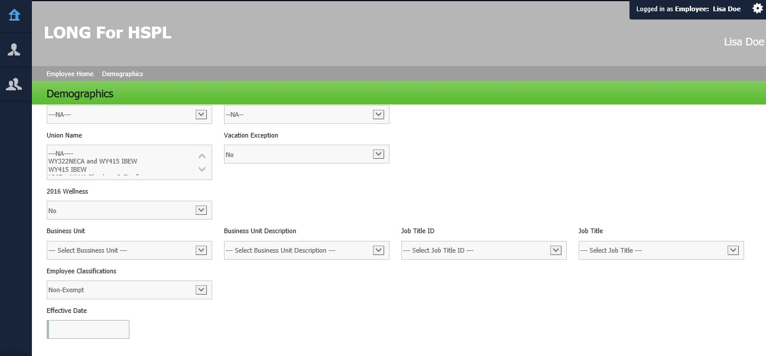
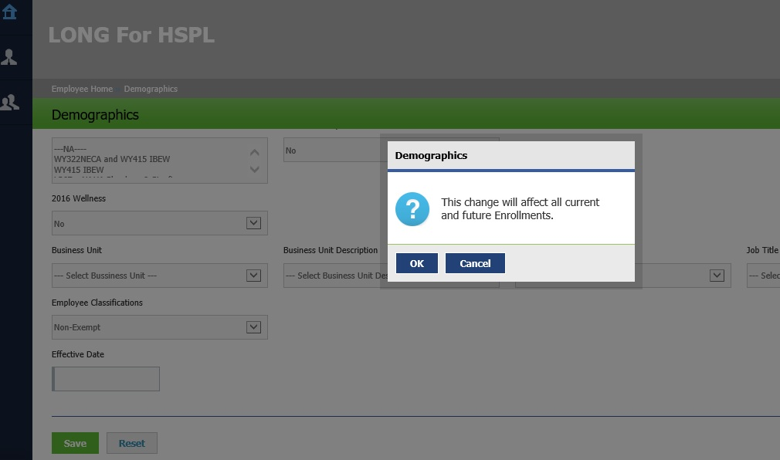
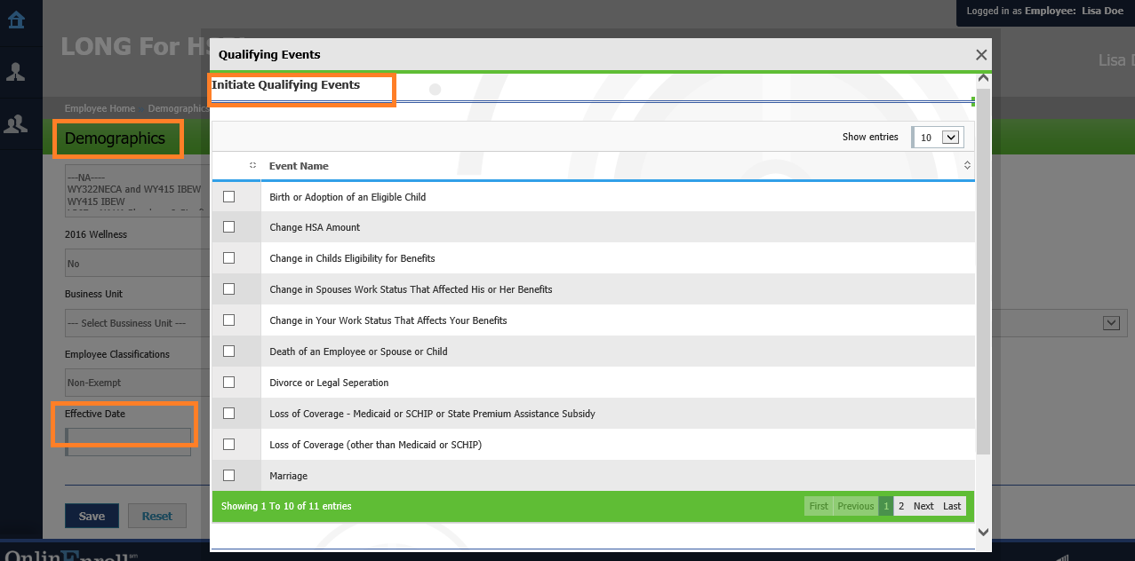
Post New Hire (With No Mode Available) – Static Forms
System Form (e.g. Demographics)
Popup Shown on Saving the Page
Popup Shown for Initiating Qualifying Event

Slide 28
Post New Hire (With No Mode Available) – Static Forms
System Form (e.g. Demographics)
Popup Shown on Saving the Page
Popup Shown for Initiating Qualifying Event

Slide 29
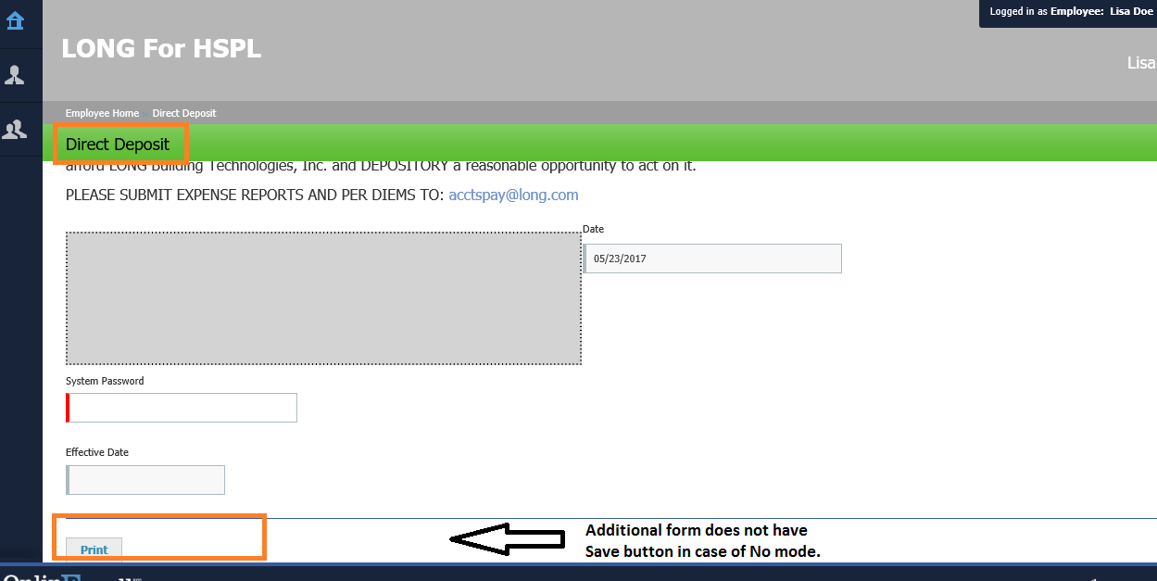
Post New Hire (With No Mode Available) – Additional Form
Additional Form – No Save button

Slide 30
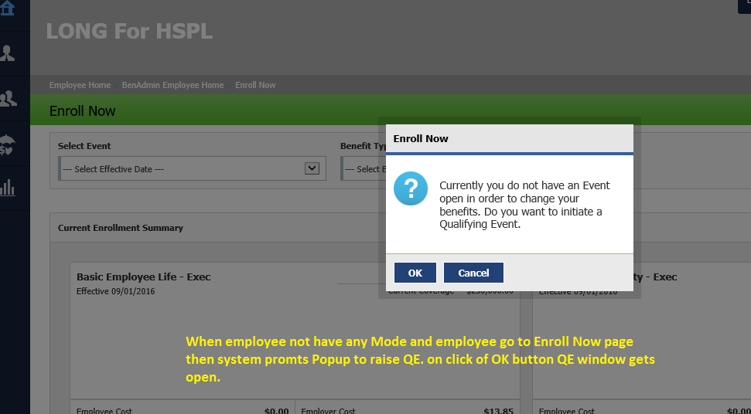
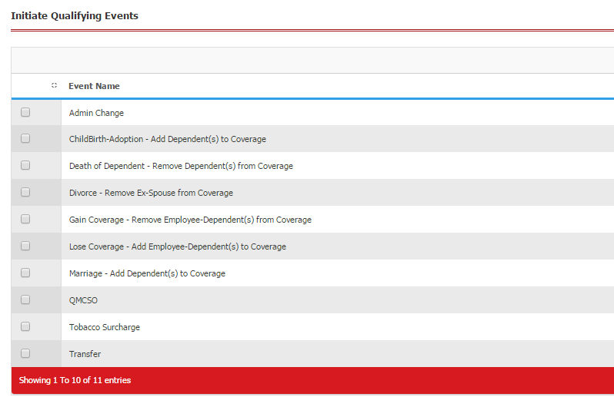
Post New Hire (With No Mode Available) – Enroll Now Page
Enroll Now Page – In absence of mode, Popup is shown asking to initiate QE
QE Page

Slide 31
Thank You

