Slide 1
Standard Reports at Global Level

Slide 2
Types of Standard Reports
Types of Standard Reports at Company Level | Available at Global Level
Employee Census | Yes
Dependent Census | Yes
Eligibility | Yes
Enrollment | Yes
Billing Details | Yes
Payroll Deduction | Yes
System Utilization | Yes
Commission Details | Yes
Fee Details | Yes
Benefit wise Billing Details | No

Slide 3
Standard Reports at Company Level
For each type
  Multiple reports can be created
  Each report has
    An eligibility criteria and fields to be shown
    These could be different across reports
Example: Consider ‘Employee census’ type
  One may create 3 reports
    Employee census 2017
    Employee census 2016
    Employee census 2015
  Each of these report will have their own eligibility and list of fields

Slide 4
Standard Report at Global Level
To use a standard reports at global level
  Corresponding standard reports has be created in all companies across which report has to be run.

Slide 5
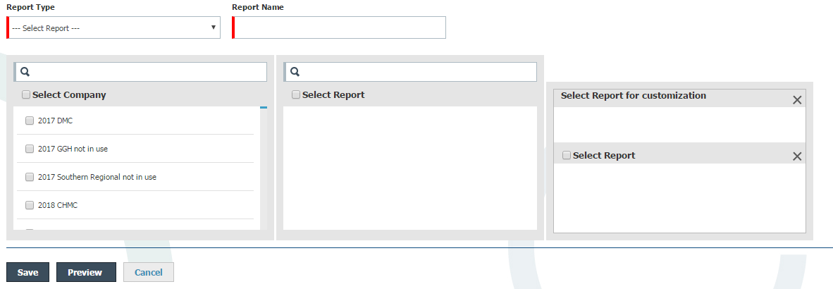
Customizing Standard Reports at Global Level
1
2
List of standard report types on global level.
- Only 1 value can be selected
1
3
2
Name for the report
3
List of companies to which logged in user has access
- Multiple companies can be selected

Slide 6
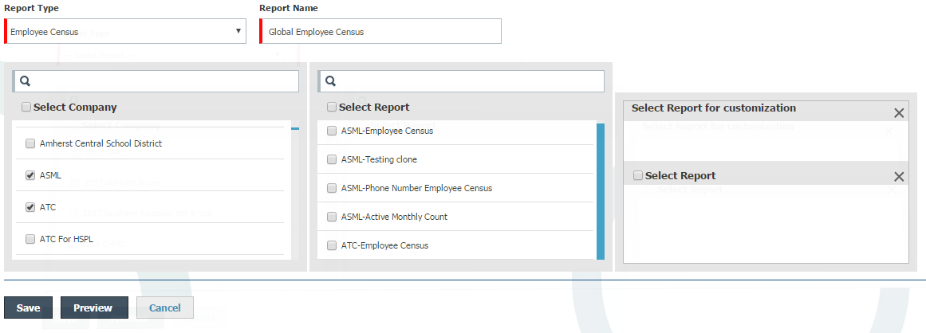
Customizing Standard Reports at Global Level
1
2
Fields 1,2 and 3 are defined
1
Report type – Employee Census
2
Report Name – Global Employee Census
3
4
3
Companies – ASML and ATC
4
Select Report
List of all standard reports created in selected companies for the selected report type.
In this case, all standard reports of type ‘Employee census’ from ASML and ATC
Format “Company Name – Report Name”

Slide 7
Customizing Standard Reports at Global Level
1
2
From list of reports in (4), select a report and then drag and drop reports into (5) and (6)
Only 1 report can be moved in (5)
Multiple reports can be moved in (6)
3
4
5
6
Existing Issue:
Report can be moved from (4) to (6) without selection in (4).
  This will be changed (WT-10090)

Slide 8
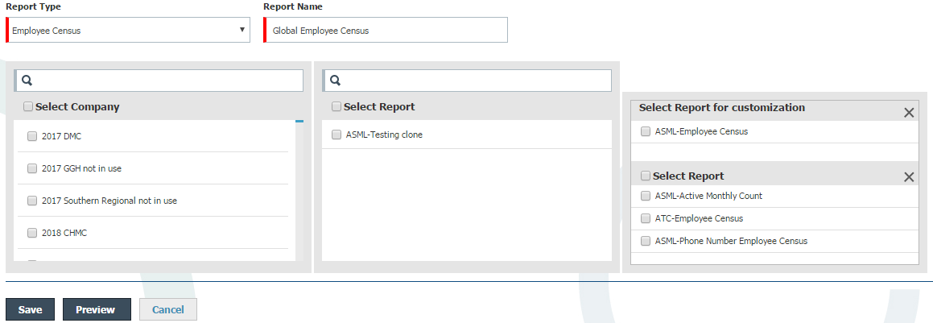
Customizing Standard Reports at Global Level
1
2
5
Select report for customization
Report added here acts as the base report for global report.
  Columns (fields)in global report would be as per fields in this report.
  If the report has 12 fields, the global report would have those 12 fields.
The data is fetched as per the customization of the report.
  Additional column for company name is added.
3
4
5
6

Slide 9
Customizing Standard Reports at Global Level
1
2
6
Select Report
Multiple reports can be added here.
Eligibility from each of these report is used and the data for fields specified in base report i.e. (5) are retrieved for employees satisfying eligibility criteria.
For example, if the eligibility criteria in 3 reports identify 3 employee groups E1, E2 and E3. Then the 12 fields will be fetched for these 3 employee groups.
Global Report = Base Report Data (5) + Data fetched using each of the report in (6).
3
4
5
6
Note: If the base report has additional fields, no data is shown for them in global report as these fields are not available across all selected companies

Slide 10
Thank You!

