Slide 1
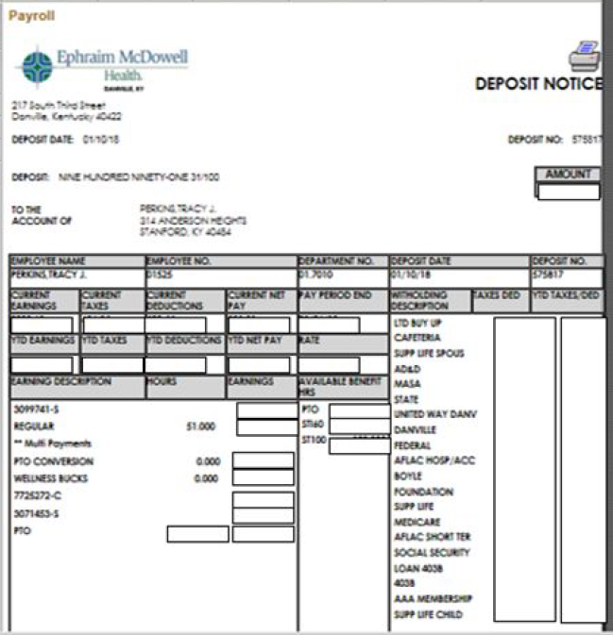
Pay check - Required
Areas marked in colored boxes are tables

Slide 2
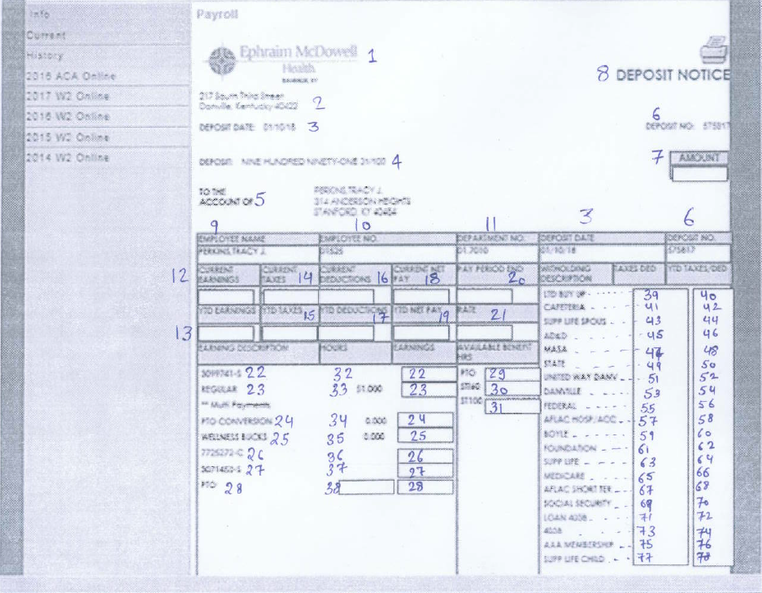
Pay check - Fields
Fields marked in red are capturing hours

Slide 3
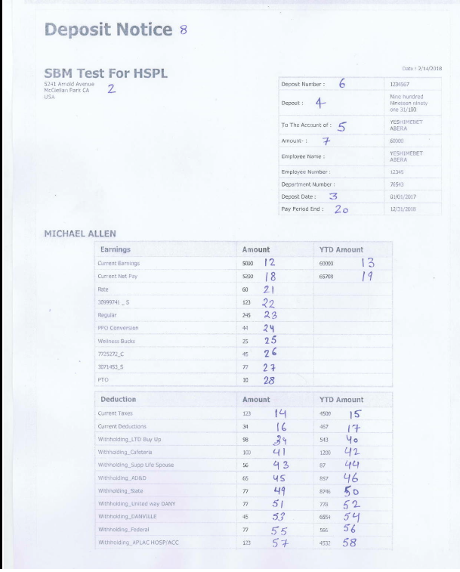
Generated Pay Check – Page 1
Logo not shown due to bug
Earnings table shown in 2nd table.
Withholding table shown in 3rd table of deductions
Fields 32-38 and 29-31 are not captured. These are hour fields
Columns headers in 2nd and 3rd table are not configurable
Values needs to be passed in file
Line items need to be added in paycheck format page

Slide 4
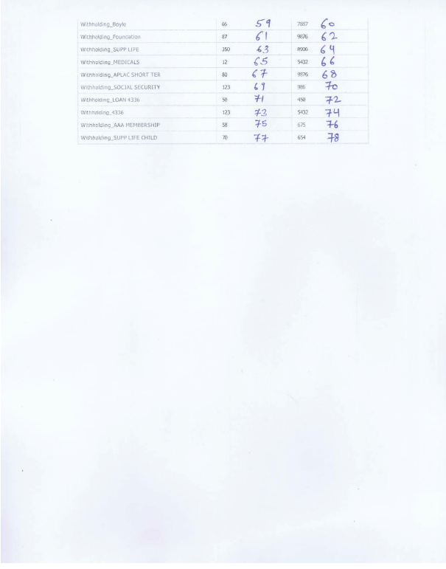
Generated Pay Check – Page 2
3rd table showing withholdings continued over here

Slide 5
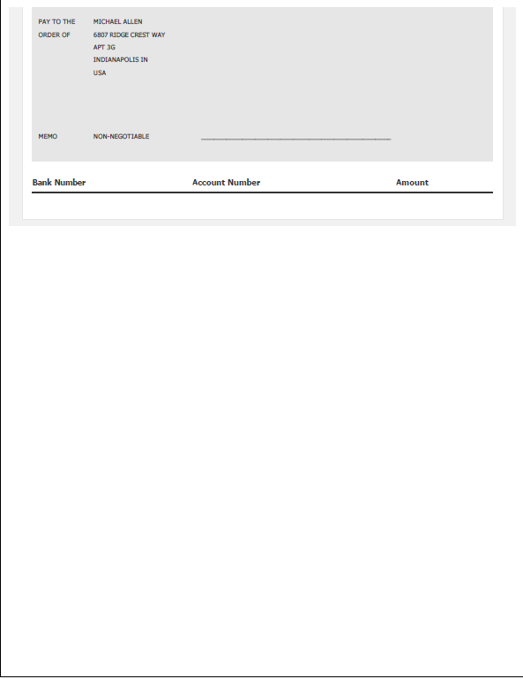
Generated Pay Check – Page 3
Pay check generated in WORKTERRA
This is not required as per format

